Slide 1

IMAGE PROCESSING USING SOCKET PROGRAMMING
Submitted by :
ARATRIKA RAY (A91005219084)
ANANYA MUKHERJEE (A91005219098)
ANWESHA RAY (A91005219130)
GADAMSETTI BHARGAVA VENKATA SUBHASH (A91005219136)
ATTULURI AVINASH GUPTHA (A91005219137)

Slide 2
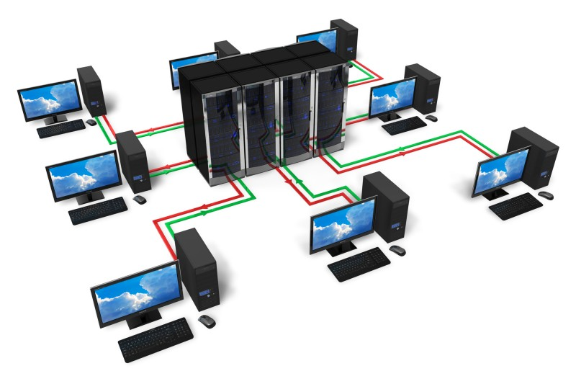
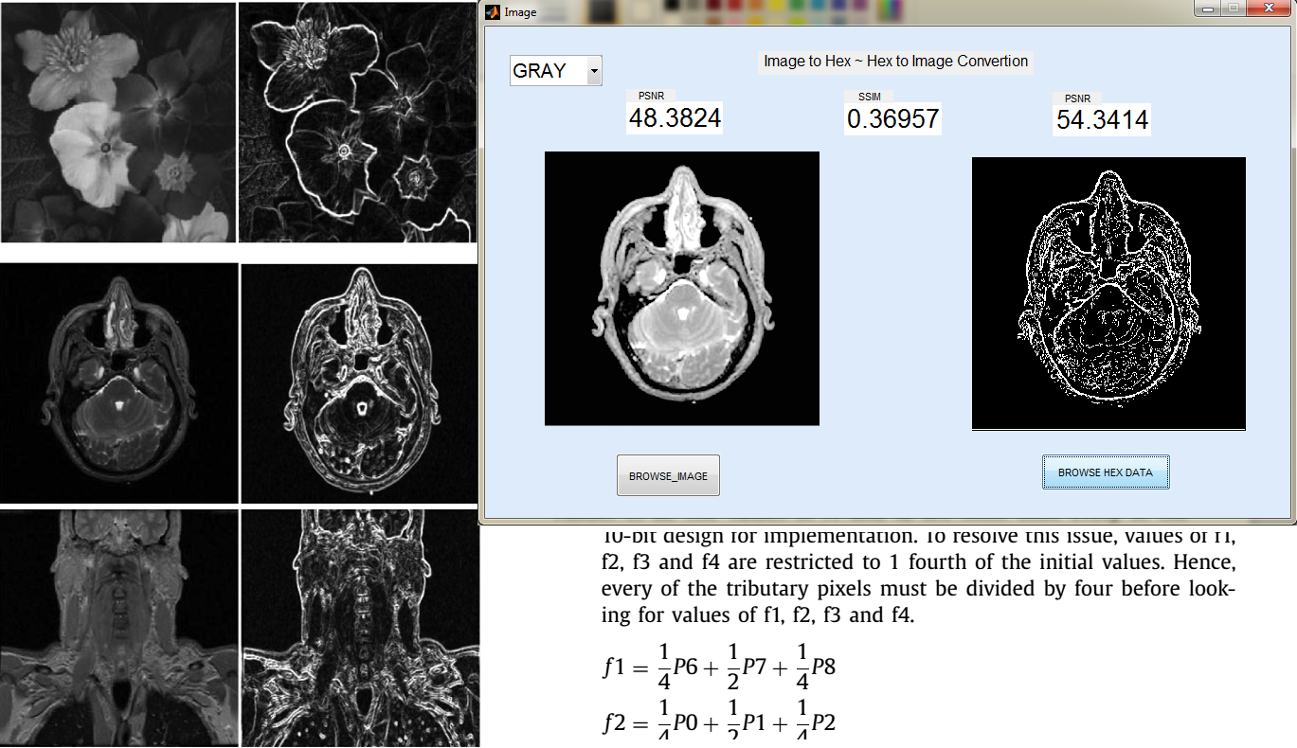
ABOUT
In this project we send an image from a client to a server. We will be performing edge detection operation of image processing on the image being sent. The server receives the image and splits it into two equal halves after which it individually saves them. The server then sends these images to the client1 and client2. Each of these clients perform edge detection upon the respective images received by them and sends the processed images back to the server. The server then merges the images which is now ready to be sent back to the original client.

Slide 3
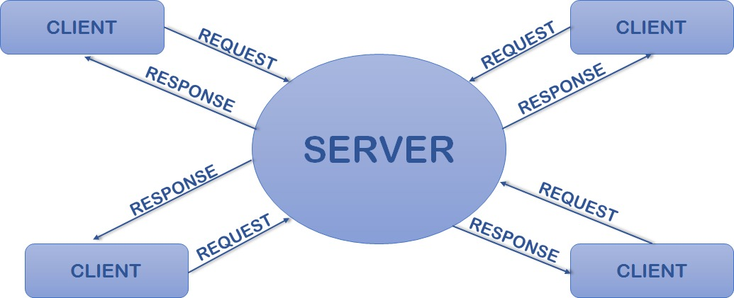
Socket Programming
Socket programming is a way of connecting two nodes on a network to communicate with each other. One socket(node) listens on a particular port at an IP, while the other socket reaches out to the other to form a connection. The server forms the listener socket while the client reaches out to the server.

Slide 4
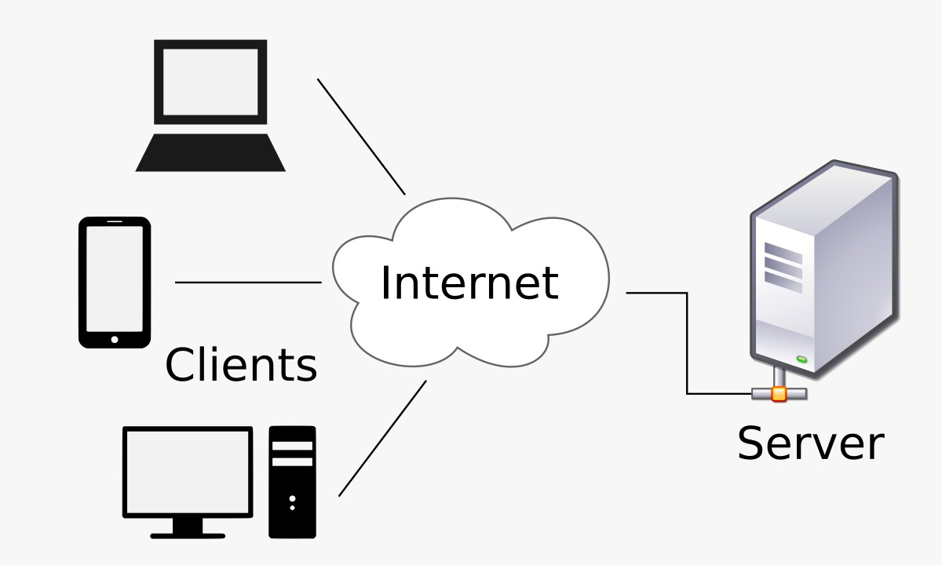

CLIENT-SERVER
ARCHITECTURE
Several clients use client-server architecture, a type of computer network architecture, to request and receive services from a single, centralized server (host computer). Client computers offer an interface via which a computer user may ask a server for services and view the results the server provides. Client queries are received by servers, which subsequently react to them.

Slide 5
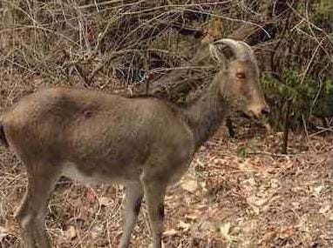
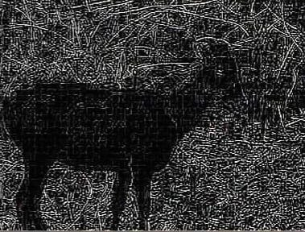
EDGE DETECTION
Edge Detection, is an Image Processing discipline that incorporates mathematics methods to find edges in a Digital Image.

Slide 6
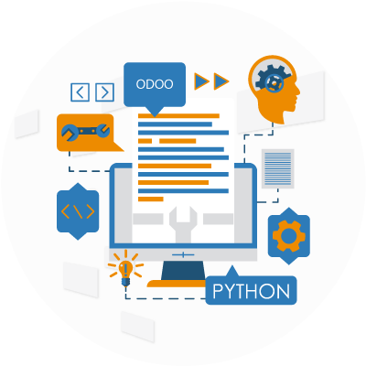
MODULES & LIBRARIES
import socket : Importing the socket library is the first step to using a socket object in your program.
import thread : Import thread is used to create a new thread by importing the threading module, as shown.
from PIL import Image : The Python Imaging Library, or PIL, gives the Python interpreter the ability to modify images.
from PIL import ImageFilter : The ImageFilter module contains definitions for a pre-defined set of filters, which can be used with the Image.filter() method.

Slide 7
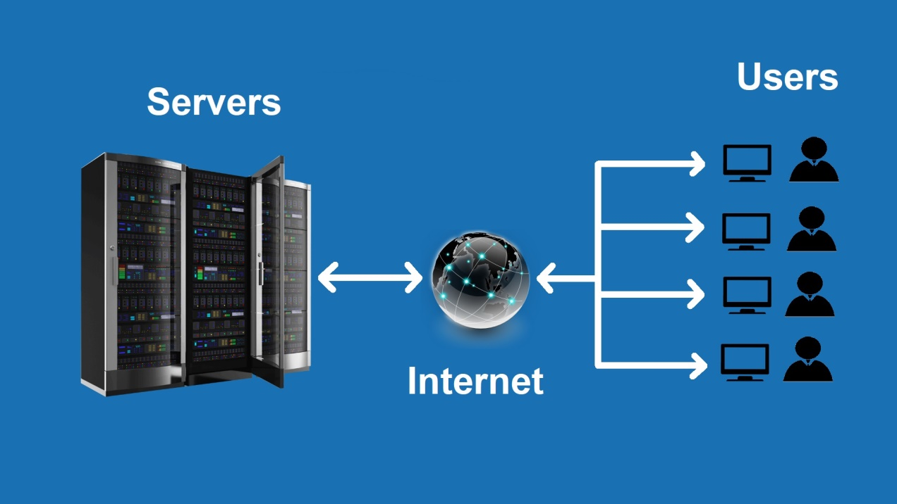
Server
1. In the server.py file we create multiple threads to listen to client connections and then direct each connection to the respective methods created for them.
2. Inside the handle_client() method we connect with the client which is sending an image for processing. We receive the image and then perform cropping operation upon it to divide it into two halves. After this we save the divided images.
3. Inside the handle_client1() method we connect with client1 to send the first saved image. Here, we also receive the image processed by client1.
4. Inside the handle_client2() method we connect with client2 to send the second saved image. Here, we also receive the image processed by client2.
5. We now merge the two images received from client1 and client2. The merged image is now ready to be sent to the original client.
EXPERIMENTATION

Slide 8

Client
This client connects with the server and opens the image to be sent to the server for processing. It finally sends the image for edge detection operation.
Client1
1. This client connects with the server and receives the first saved image sent by the server for it to process.
2. It performs edge detection operation on the opened image and then sends it back to the server.
Client2
1. This client connects with the server and receives the second saved image sent by the server for it to process.
2. It performs edge detection operation on the opened image and then sends it back to the server.

Slide 9
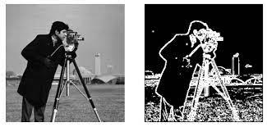
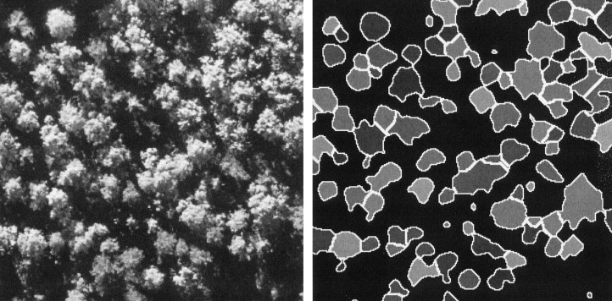
RESULT & DISCUSSION
In this client-server project, we have sent an image to be processed from a client to the server. The server then splits the image received into two halves and sends it to two clients namely client1 and client2 for processing. This process is done to increase the speed of computation. The two clients process the images by performing edge detection and resend it to the server. Server then merges the processed image which now is required to be sent to the original client.

Slide 10

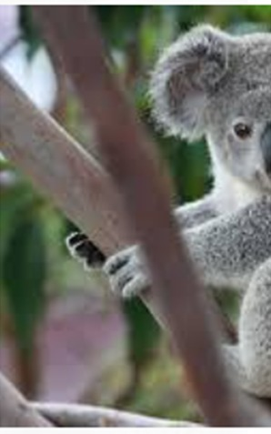
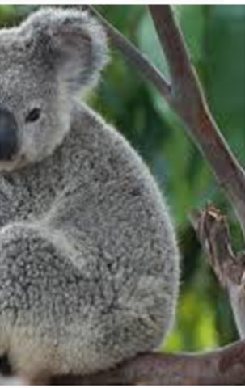
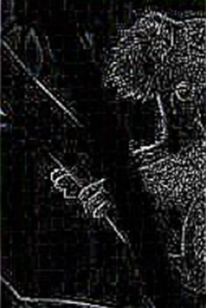
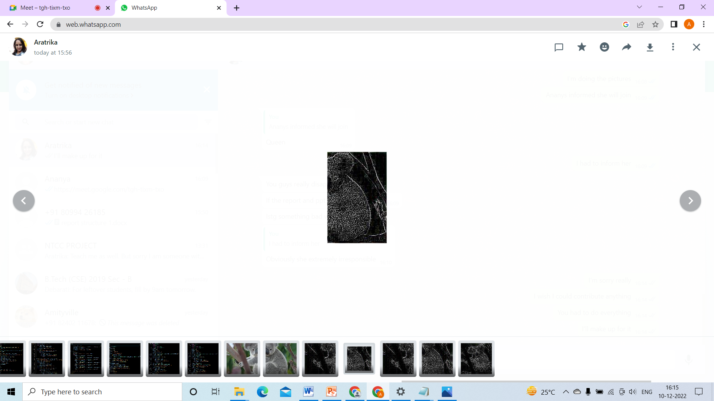
SERVER
Split Images
Processed Images received from client1 and client2
s_image1.jpeg
s_image2.jpeg
client1_edit.jpeg
client2._edit.jpeg

Slide 11
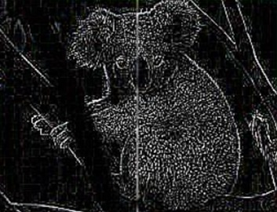
SERVER CONTINUED
Merged Image
m_image.jpeg

Slide 12
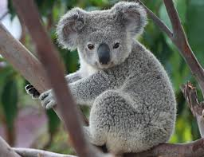
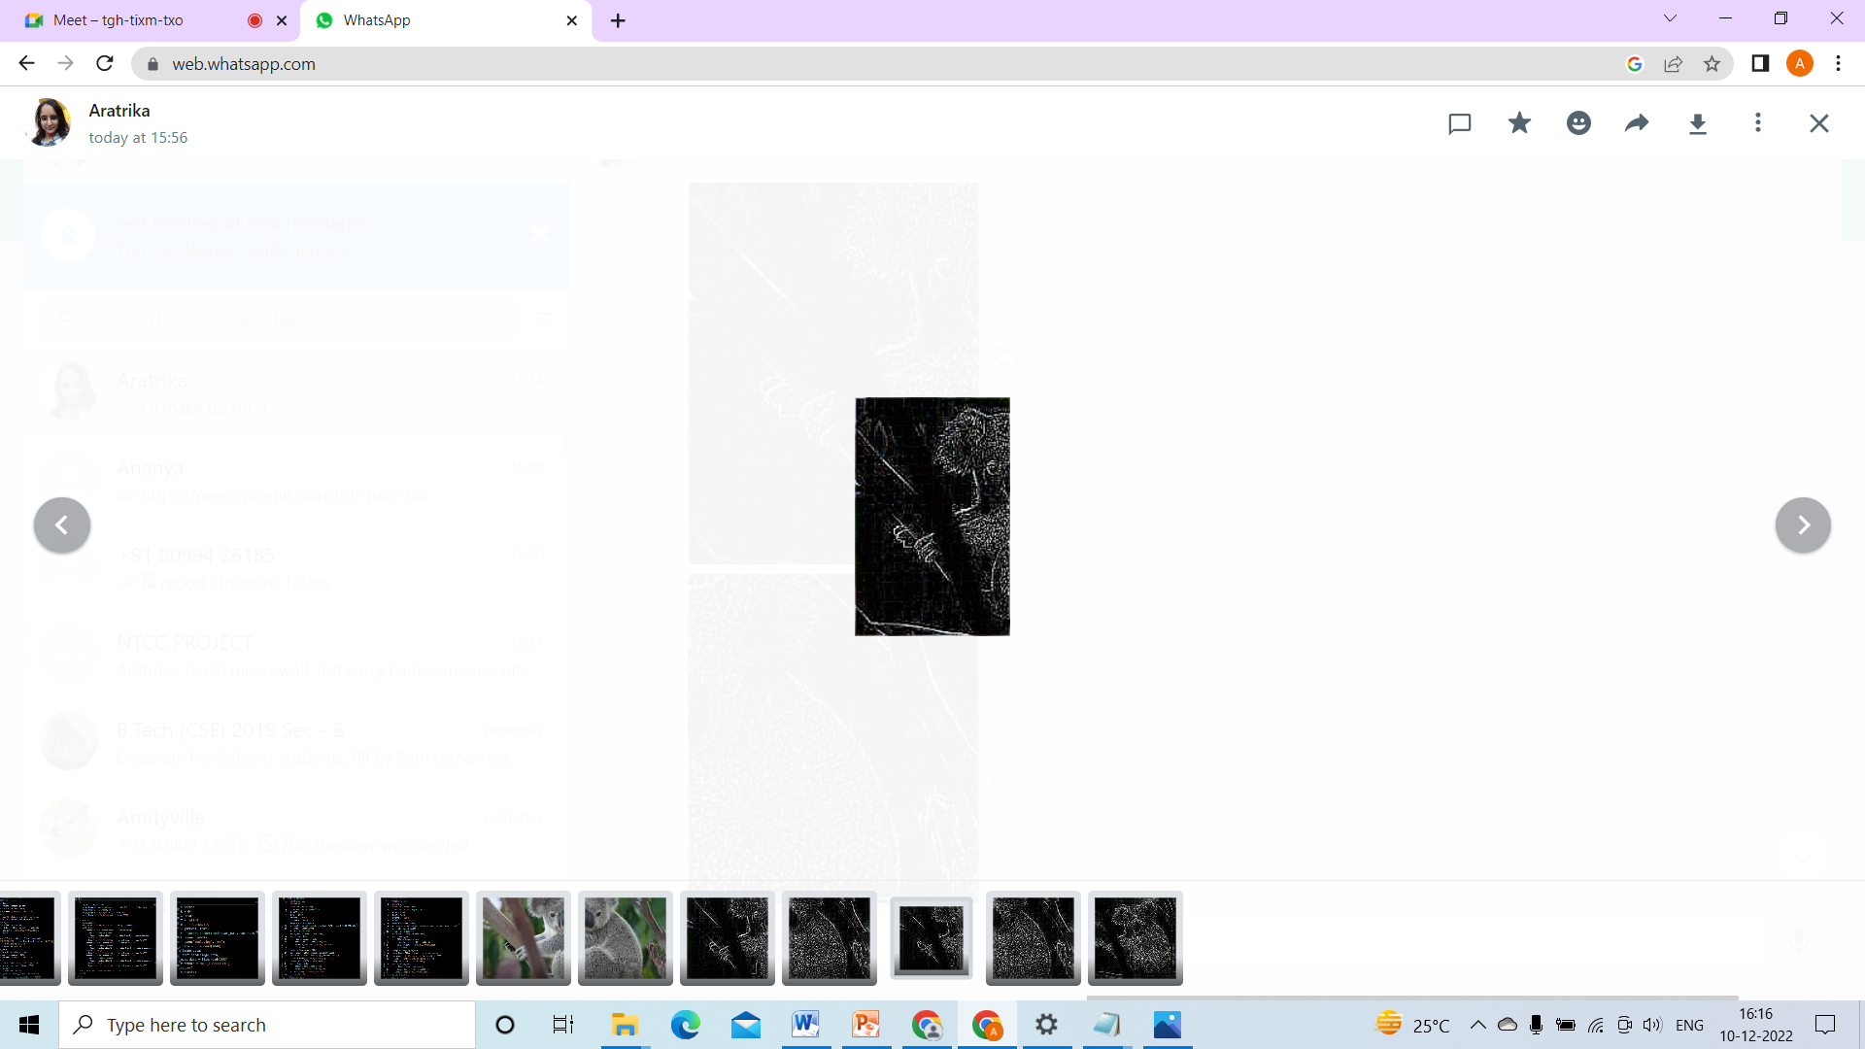
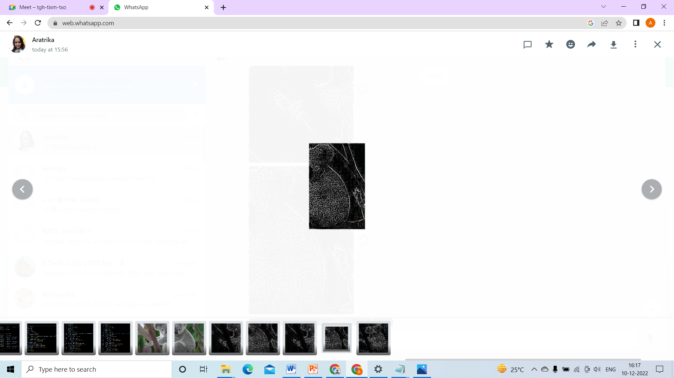
CLIENTS
Image to be sent for processing
Images after edge detection is performed
Client Client1 Client2
koala.jpg client1_image.jpeg client2_image.jpeg

Slide 13
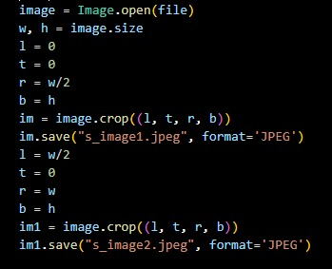
CODE SNIPPETS
Splitting image into two halves

Slide 14

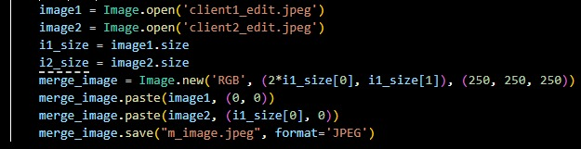
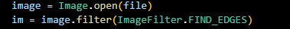
Merging of the processed image
Edge Detection

Slide 15
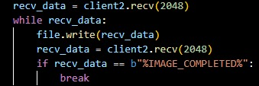
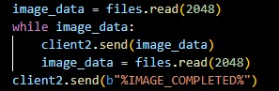
Receiving image (snippet is taken from client2.py)
Sending image (snippet taken from client2.py)

Slide 16
CONCLUSION
From this project we have gained knowledge upon client-server socket programming and how we can ease a work by using this method. Our project focuses upon the benefit of having multi-client and server connection to increase the speed of image processing. This process is of immense help for receiving fast results.

Slide 17
THANK YOU!

